Slide 1
Adventures in MitM-land
Using MITM to Attack Active Directory Authentication Schemes

Slide 2
About Us
Sagi Sheinfeld (@sagish1233)
Senior Engineer @CrowdStrike (Former @Preempt)
Eyal Karni (@eyal_karni)
Senior Manager, Engineering @CrowdStrike
Extensive background as a security researcher
Senior Engineer @CrowdStrike (Former @Preempt)
Yaron Zinar (@YaronZi)
Previously presented on Black Hat
2xBlack Hat, 1xDEFCON

Slide 3
Is MITM an Important Technique?
Sometimes…
Works when other techniques fail
Often overlooked…
Active Directory
Relatively old protocols
Usually don’t use TLS

Slide 4
NTLM Basics
(1) NTLM Negotiate
(2) NTLM Challenge
(3) NTLM Authenticate
(4) NETLOGON
(5) Approve/Reject
Client Machine
Server
DC
Authentication is not bound to the target server!

Slide 5


Kerberos Basics
(1) AS-Req
(2) AS-Rep
(3) TGS-Req
DC
(4) TGS-Rep
Signed with server’s secret
(5) AP-Req
Client Machine
Server

Slide 6
Kerberos vs. NTLM
 | NTLM | Kerberos
Proteted from Offline Cracking | ✗ | ✓ (except X-roasting)
Can Work w/o Storing Hash in RAM | ✗ | ✓
Supports Mutual Authentication | ✗ | ✓
Smart Card Support | ✗ | ✓
Hashes Contain Salt | ✗ | ✓ (except RC4)

Slide 7
NTLM Relay 101
(2) NTLM Negotiate
(8) Approve
(3) NTLM Challenge
(7) NETLOGON
(6) NTLM Authenticate
Attacked
Target
(1) NTLM Negotiate
(4) NTLM Challenge
(5) NTLM Authenticate
Client Machine
Server
DC

Slide 8
NTLM Relay over DCE/RPC
First suggested by Sylvain Heiniger (@sploutchy)
Found (at least) one interface (TSCH) with no server signing
Used NTLM Relay to create a new scheduled task

Slide 9
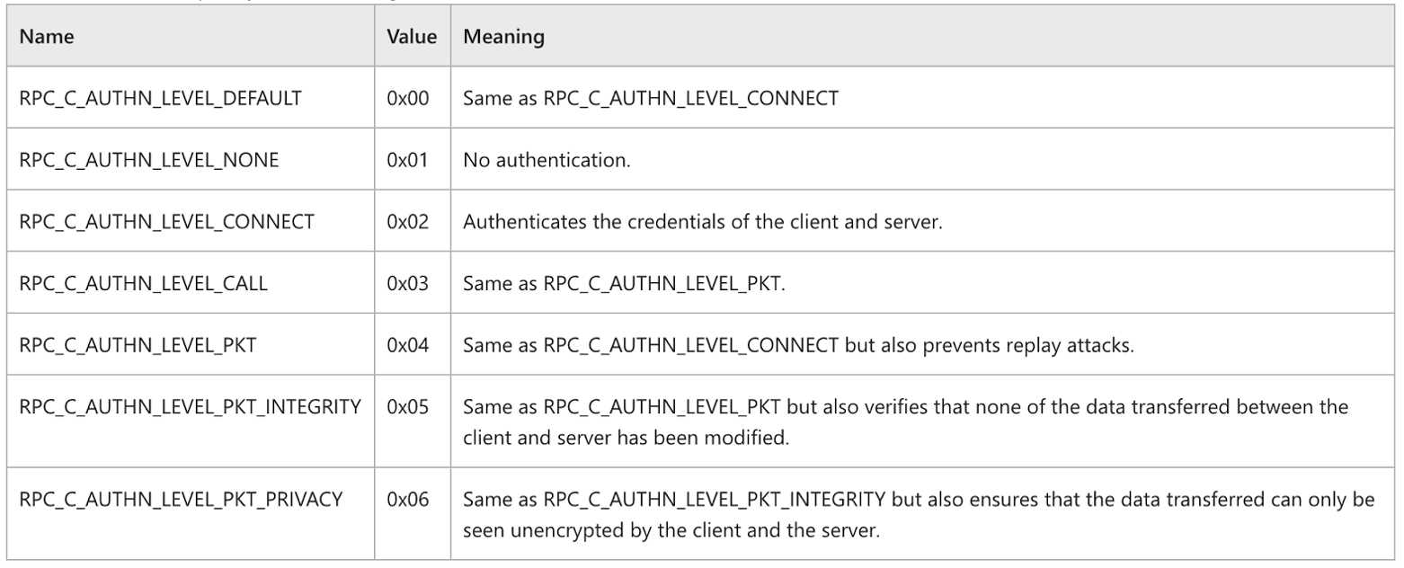
DCE/RPC Relay Mitigation is Broken
https://docs.microsoft.com/en-us/openspecs/windows_protocols/ms-rpce/425a7c53-c33a-4868-8e5b-2a850d40dc73

Slide 10
Printer Spooler LPE (CVE-2020-1048)
Discovered by Peleg Hadar (@peleghd) and Tomer Bar
For printing, you need a driver, and a port
Any user can install a printer driver (from a pre-existing list)
“Generic/ Text” can write anything...
The port can be a file instead ⇒ We can write arbitrary files
It is a privileged process, and the access checks are done on the client side ⇒ We have an LPE

Slide 11
CVE-2021-1678
Was found using our RPC scanning tool
Targeting MS-PAR (IRemoteWinSpool) Interface
Interface has only required RPC_C_AUTHN_LEVEL_CONNECT
Support remote printer operations
Works the same as CVE-2020-1048 (just remotely)
RpcAsyncInstallPrinterDriverFromPackage (Opnum 62) — Installing “Generic/Text” printer driver
RpcAsyncOpenPrinter (Opnum 0)
RpcAsyncXcvData (Opnum 33) — Add port
RpcAsyncAddPrinter (Opnum 1) — Add a printer with the mentioned driver
RpcAsyncStartDocPrinter(Opnum 10) — Start a new document
RpcAsyncWritePrinter (Opnum 12) — Write to new document

Slide 12
CVE-2021-1678
Client Machine
Rogue Server
DC
(1) NTLMSSP_ NEGOTIATE
(2) RPC Bind (IRemoteWinSpool)
(3) NTLMSSP_NEGOTIATE (Relayed)
(4) NTLMSSP_CHALLENGE
(5) NTLMSSP_CHALLENGE (Relayed)
(6) NTLMSSP_AUTHENTICATE
(7) NTLMSSP_AUTHENTICATE (Relayed)
(8) RpcAsyncInstallPrinterDriverFromPackage
(9) Several Printer RPC Commands
(10) RpcWritePrinter (Writing a file remotely)

Slide 13
DEMO

Slide 14
MS15-011
Initially discovered by Luke Jennings (@jukelennings)
Attacking GPO retrieval using MITM
Many attack scenarios
Both RCE and privilege escalation
Some scenarios are still exploitable

Slide 15
MS15-011 Explained
Client Machine
Rogue Server
DC
(1) LDAP Bind
(2) NTLM Negotiate
(3) NTLM Challenge
Target name: Rogue Server
(4) NTLM Authenticate
(5) NetLogonSamLogon Request
DC accepts request since Target is Rogue Server
(6) NetLogonSamLogon Response
Contains: session key
(7) accept-complete
(8) LDAP Search (GPO search)
(9) LDAP Search Response
Redirects GPO to malicious UNC path

Slide 16
MS Fixes for MS15-011
GPO retreival can no longer operate with NTLM
Registry Key
Hardened UNC Paths
Configuration to block NTLM usage in SMB
Defaults
\\*\SYSVOL
\\*\NETLOGON

Slide 17
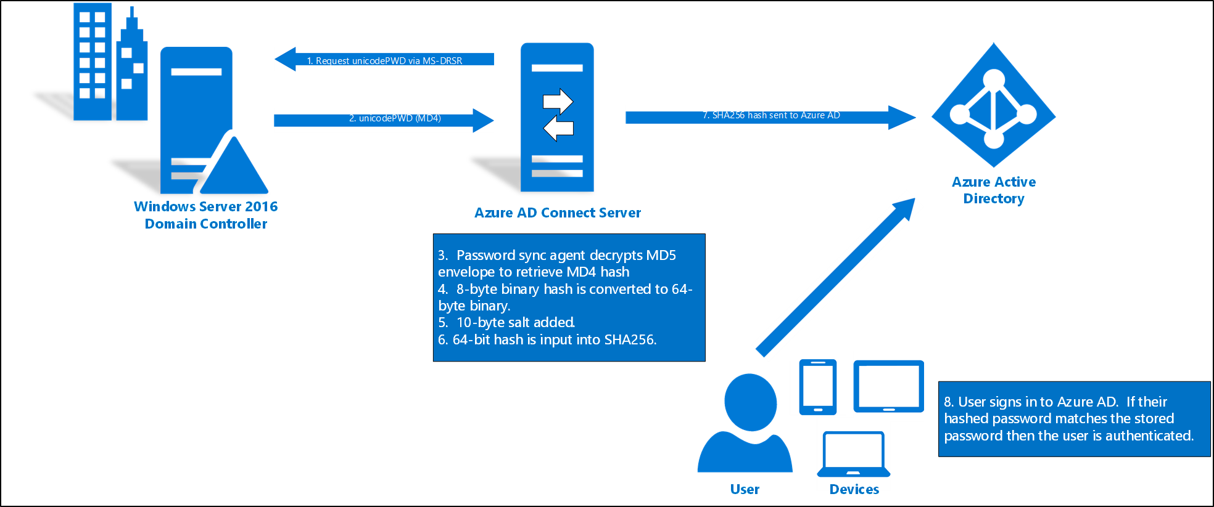
Azure AD Connect
https://docs.microsoft.com/en-us/azure/active-directory/hybrid/how-to-connect-password-hash-synchronization

Slide 18
Azure AD Connect MITM Attack
MITM Between Azure AD Connect and DC
Attack Steps:
Establish a full MITM , make Kerberos fail while allowing LDAP to pass to the DC
Wait for domain replication in NTLM
Inject new change MD4 password for an account of your choice
Log in to Azure AD with injected password

Slide 19
DEMO

Slide 20
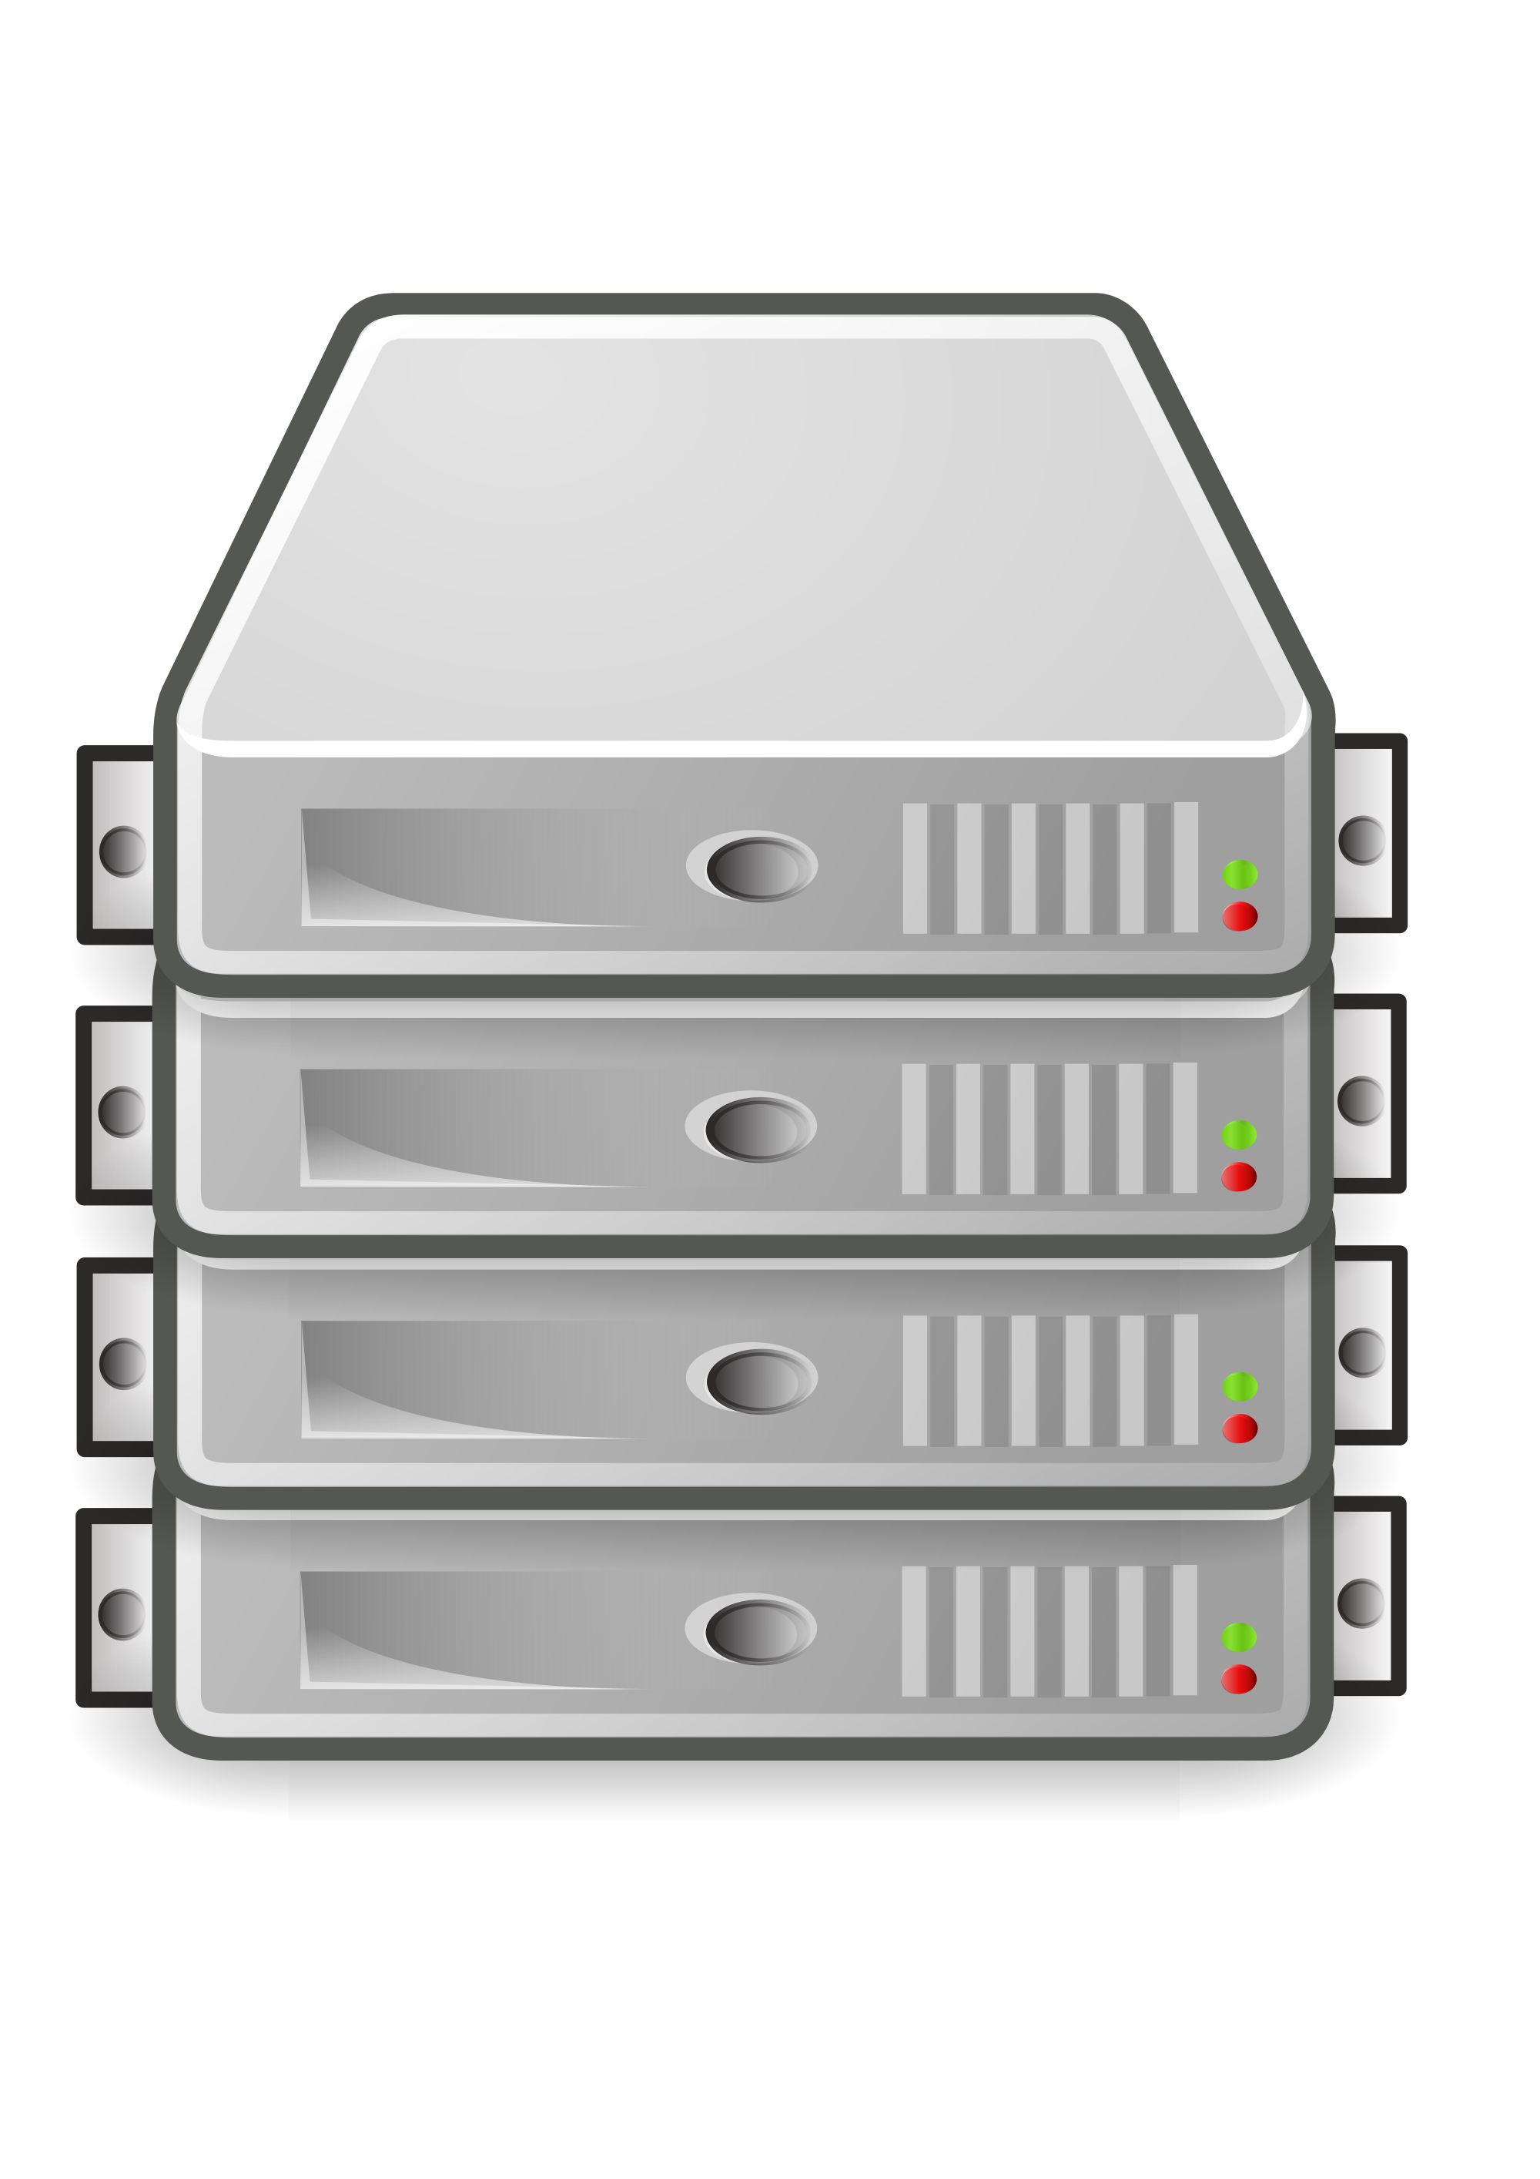
Kerberos Relay
Same as NTLM Relay (actually much easier)
Just to the original target server
(1) Kerberos AP-Req
(2) Kerberos AP-Req
Client Machine
Attacked
Target

Slide 21
Kerberos Relay – Cont.
SMB Relay
Works the same as with NTLM
Attacker can negotiate no signing if server signing is not required (default)
(1) Kerberos AP-Req
(2) SMB Bind (Signing Negotiate)
(3) Kerberos AP-Req
Client Machine
Attacked
Target

Slide 22
Kerberos Relay over TLS
Relay protection in TLS channels
Extended Protection for Authentication
Important examples of such protection
LDAPS (called Channel Bindings)
AD FS
IIS
Can this be bypassed?
NTLM (check out our DEFCON 2019 talk ☺)
Kerberos
AP-Req contained signed certificate thumbprint inside checksum field
What happens when Kerberos client has no checksum field?

Slide 23
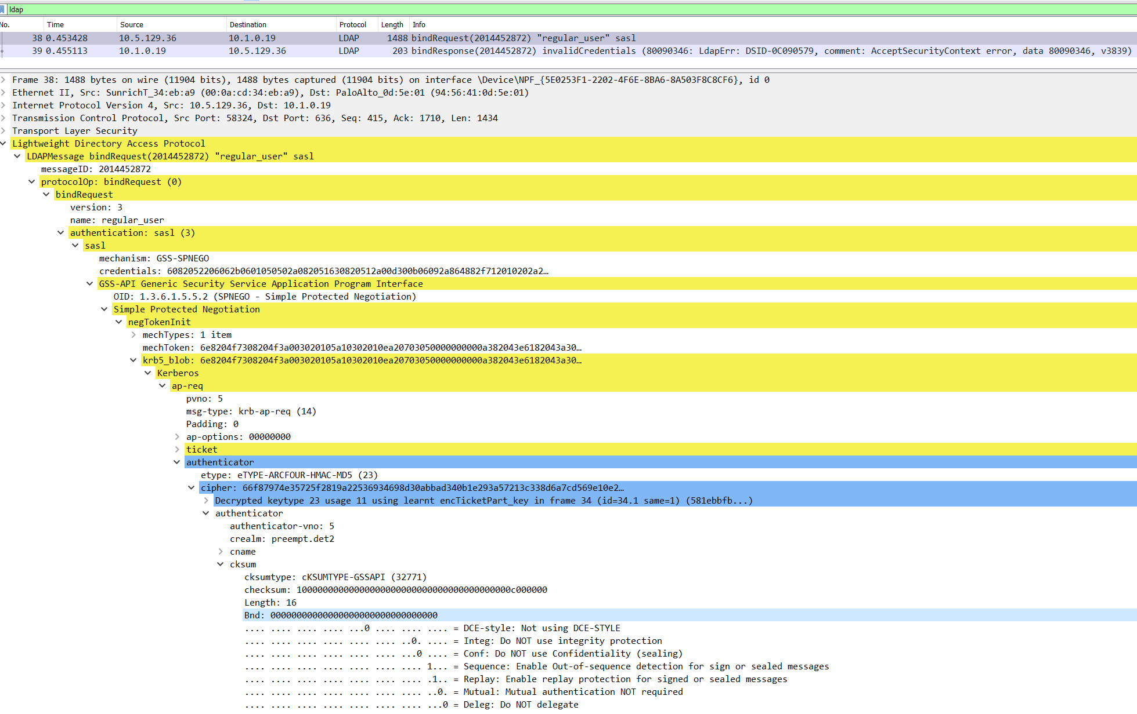

Slide 24
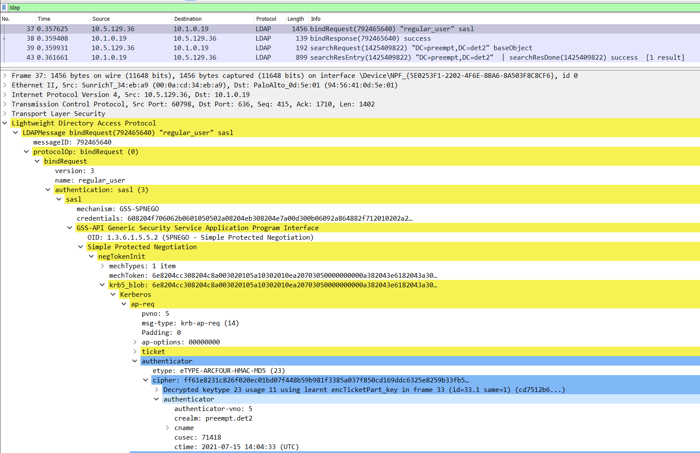

Slide 25
KDC Spoofing
KDC Spoofing
Old Technique
Using MITM for authentication bypass
Typically exists in VPNs, FWs
(1) Plaintext Credentials (over HTTPS, TLS, etc.)
(2) Kerberos AS-Req
(2) Kerberos AS-Req
(3) Kerberos AS-Rep
Using: Fake Password
Authentication Server (VPN, FW)
Client Machine
MITM
DC

Slide 26
KDC Spoofing Protection
Very old technique
Protection
Create a computer account for authentication server
Create a TGS ticket to self using TGT
(1) Plaintext Credentials (over HTTPS, TLS, etc.)
(2) Kerberos AS-Req
(3) Kerberos AS-Rep
(4) Kerberos TGS-Req
(5) Kerberos TGS-Rep
DC Proves identity by signing with server’s secret
Authentication Server (VPN, FW)
Client Machine
DC

Slide 27
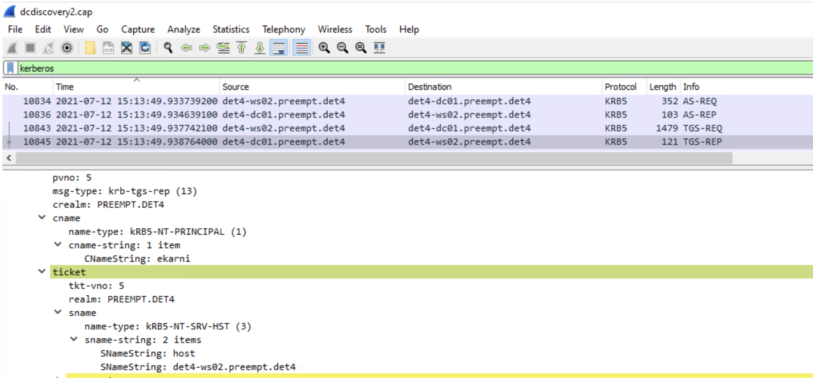
Kerberos Injection

Slide 28
Kerberos Injection
So, we cannot manipulate TGT and TGS, what now?

Slide 29
DC Selection Process
Client Machine
DNS
DC
DC
(1) Lookup DCs in domain.com
(2) List of DC FQDNs
Picks a DC
(3) Resolve dc1.domain.com
(4) Unauthenticated LDAP “Host Ping” (Get AD site)
(5) LDAP – Get domain capabilities
(6) Get DCs in current site
Possibly Selecting another DC
(7) Establish NETLOGON Session
(8) Get Domain Info

Slide 30
Kerberos Injection
We can intervene in the DC selection process:
Client choose a DC using combination of DNS and LDAP queries
Our MITM relays AS-REQ and TGS-REQ (to self) to a real DC
MITM is able to serve subsequent DCE/RPC and LDAP requests
(As long as NETLOGON secure channel is not required)

Slide 31
Kerberos Injection
Client Machine
Rogue Server
DC
(1) DC Selection Process
(2) Injected DC
Using: Rogue Server
(3) Kerberos AS-Req
(4) Kerberos AS-Req
(6) Kerberos AS-Rep
(5) Kerberos AS-Rep
(7) Kerberos TGS-Req
(8) Kerberos TGS-Req
(10) Kerberos TGS-Rep
Signing with client secret
(9) Kerberos TGS-Rep
Signing with client secret
(11) Kerberos TGS-Req (LDAP)
(12) Kerberos TGS-Req
(14) Kerberos TGS-Rep
Signing with Rogue server’s secret
(13) Kerberos TGS-Rep
Signing with Rogue server’s secret
(15) LDAP Search
(16) LDAP Search Response
Malicious injected data

Slide 32
Kerberos Injection – Attack Scenario
A service that:
Uses Kerberos (the usual case…)
Ingests data from DC without certificate/netlogon validation (the usual case…)
Does not have a fixed DC configured (the usual case…)
MITM between the server and the DNS
The attack:
Use MITM to redirect to the Rogue DC
Client requests ticket to rogue server (SPN needs to be registered!)
Modify responses to the ingested data

Slide 33
Kerberos Injection – How to Mitigate?
Authenticate DC
Establish a NETLOGON channel
Use LDAPS with certificate validation
Use Kerberos Armoring (we have not tested this…)
Windows GPO is still safe…

Slide 34
DEMO

Slide 35
Responsible Disclosure
IRemoteWinSpool NTLM Relay
Microsoft fixed issue under CVE-2021-1678
Regarding other vulnerable interfaces: “Regarding other DCE/RPC interfaces for potential exploitation, If youl find other exploitable DCE/RPC interfaces, please submit these separately. Doing so will allow us to investigate each one individually.”
Azure AD
MS Acknowledged the issue and replied: “Thank you for reaching out. MitM requirement requires another vulnerability to be exploited to achieve a successful MitM, or a compromised connection, or some level of privileges. We also strongly recommend to treat AD Connect server as a domain controller, following hardened security practices”
Channel Bindings
MS Acknowledged the issue and replied: : “Microsoft has decided that it will not be fixing this vulnerability in the current version and we are closing this case.”
Kerberos Injection
A few vendors are working on fixing their Kerberos clients – expect updates soon

Slide 36
Closing Remarks
MITM is not a security boundary (at least for Microsoft)
More Technically:
Securing Protocols from MITM is hard
Kerberos is not validating DC identity properly
GSS-API does not guarentee protection from MITM

Slide 37
Tips for Defenders
Network Hardening
Enable server/client signing
Regularily patch software
Treat critical servers (e.g., AAD Connect) the same as DC
Kerberos Injection
Monitor suspiciously registered SPNs
Microsoft Recommendation: Avoid being MITM’d… :P

